Slide 1
OwlTalk
By Anthony Pancione, Jonah Livingston, Nicholas Child, and Tyler Do

Slide 2
Our Team
Anthony Pancione (25 Points)
Scrum Master; Milestone Documentation, Google Analytics Plot, Screenshots of final product, YouTube video creator. Usability Test Plan, Test Cases
Jonah Livingston (25 Points)
Back-End Lead; Developed code for the website (login, account, creation, and logout functionality), YouTube video creator, GitHub Contributor
Nicholas Child (25 Points)
Product Owner; GitHub Master, Code Reviewer, High Level UML Diagrams, Product Summary, Competitive Analysis, Bug List
Tyler Do (25 Points)
Front-End Lead; Developed code for the website (navigation bar functionality), site mockups and design planning, GitHub Contributor

Slide 3
Project Purpose and Summary
For our project we chose to create a communication platform that allows people who are stuck in quarantine to interact and share ideas. Due to the COVID-19 outbreak, students at FAU have been unable to communicate in a healthy sociable manner. To fix this issue, our team has come up with a website that will allow students at Florida Atlantic to create, comment and like posts made by other students. This project, named “OwlTalk”, is useful because socialization at FAU has been almost entirely erased since quarantine began. College is a critical time to socialize and create new connections. We believe there is no available platform where FAU students can freely socialize in an unmoderated environment. It will be a site of the students, by the students and for the students. The setup will be a reddit style posting board where verified users can make new posts and like/comment on old posts.

Slide 4
High-level System Architecture
Database:
MySQL
Server:
LAMP (Linux, Apache, MySQL, PHP/Perl/Python)
Languages:
HTML, CSS, PHP
Browsers:
All major browsers

Slide 5
Post Project Analysis
The main challenge we as a group had to overcome across the duration of this project was an initial lack of developmental knowledge. The features we originally envisioned for the website began in concept as overly grand and ambitious. As the project went on these designs had to be scaled down and made more realistic for us to be able to achieve. The process of ironing out the concepts into the more refined versions of themselves they eventually became was quite satisfying to witness; as it was a direct parallel to our own continued improvement as developers.
The difference in each of our team member’s time preference for working on the project was quite disparate and an issue at first as well, but as we developed our methods of communication and further organized ourselves as the project’s development went on, the project become more and more well put together. Our team’s varying skillsets were potential concerns early on but because of the improvement of our communication efforts, we easily became aware of each of our team member’s abilities and properly tasked ourselves in an efficient manner.

Slide 6
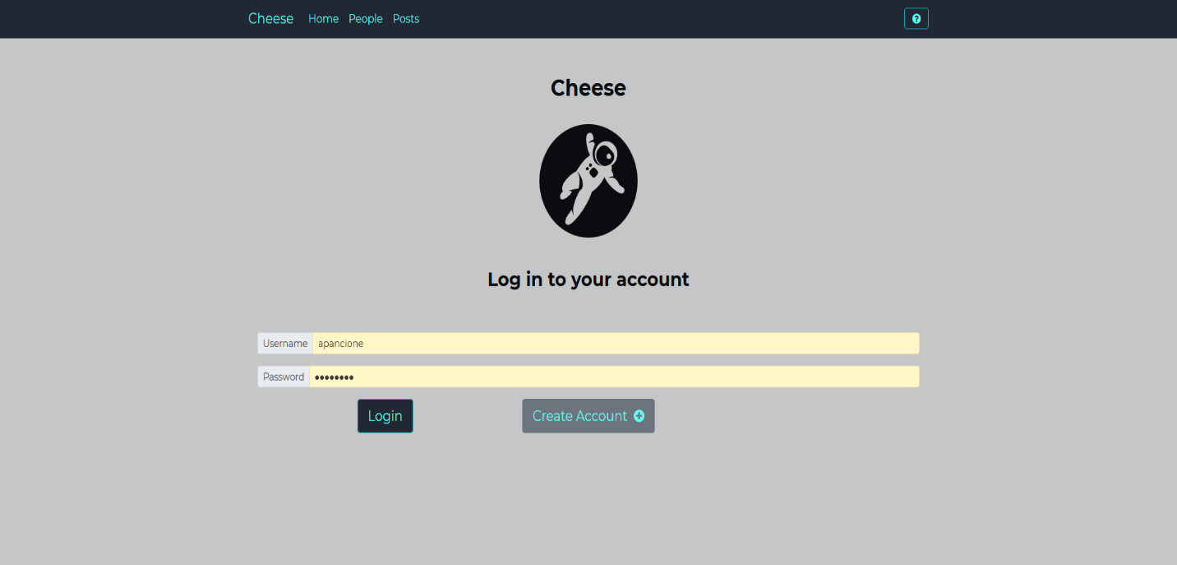
Demo – Login Page

Slide 7
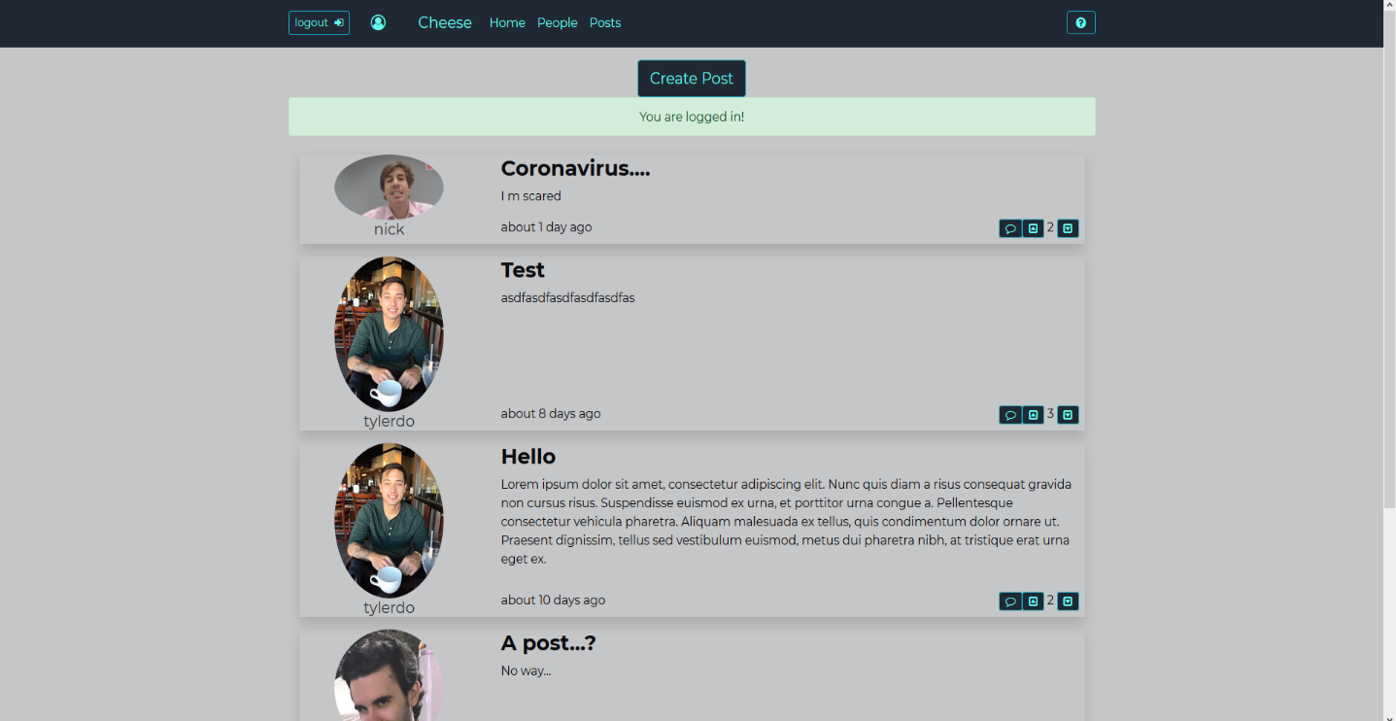
Demo – Posts Page

Slide 8
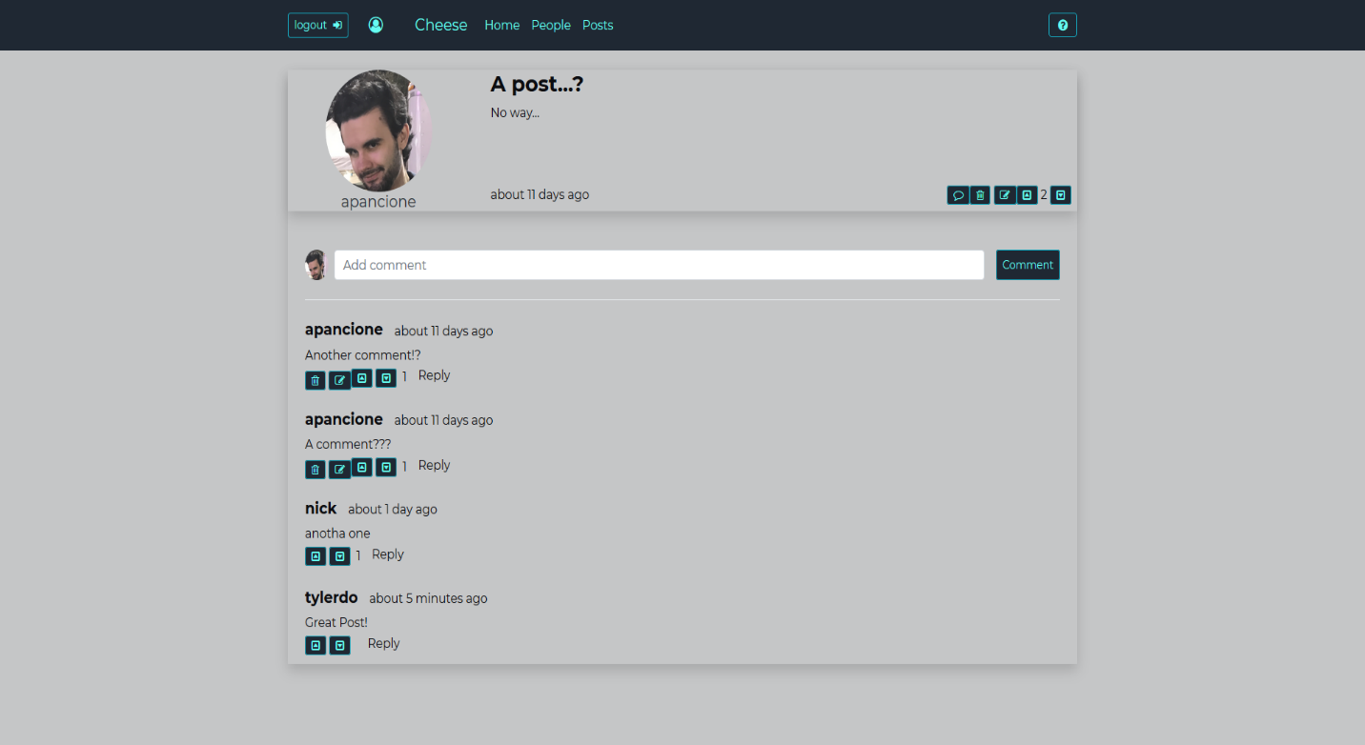
Demo – Post Block Comments

Slide 9
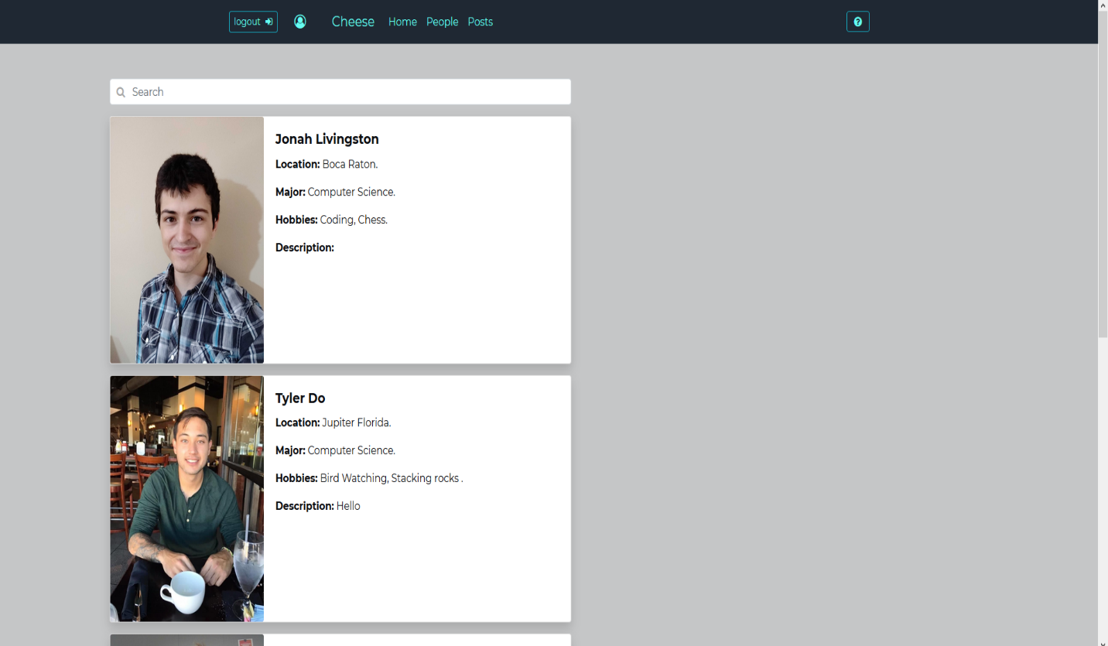
Demo – Registered Users List

